Slide 1

Sshhh… curtain
Curtains help to make a room quieter by absorbing sound.

Slide 2
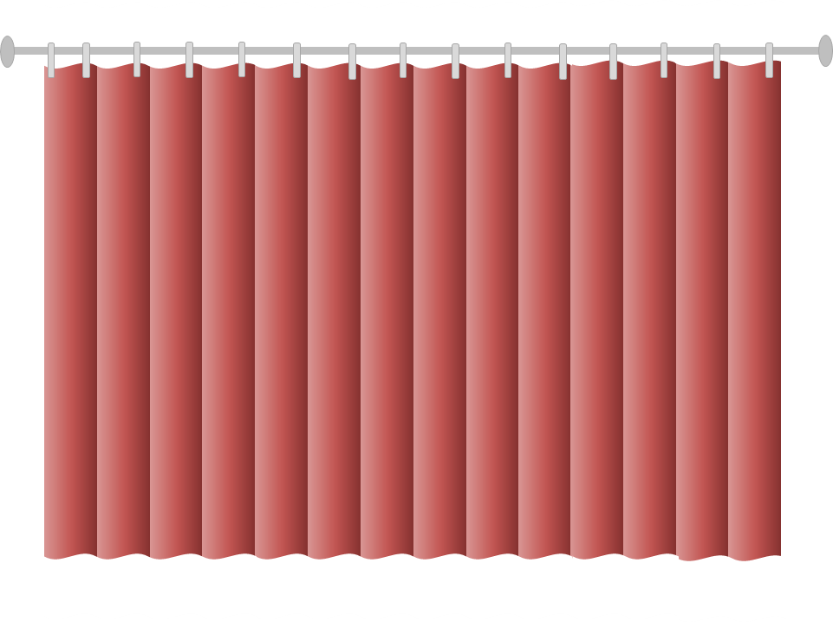
Sshhh… curtain
Read the statements about curtains absorbing sound.
Which do you think are right?
I am sure this is right
I think this is right
I think this is wrong
I am sure this is wrong
A
Curtains absorb all sound that reaches them
B
Sound makes particles in curtains vibrate more quickly
C
Particles in curtains trap sound
D
The folds in curtains help them absorb sound

